Slide 1
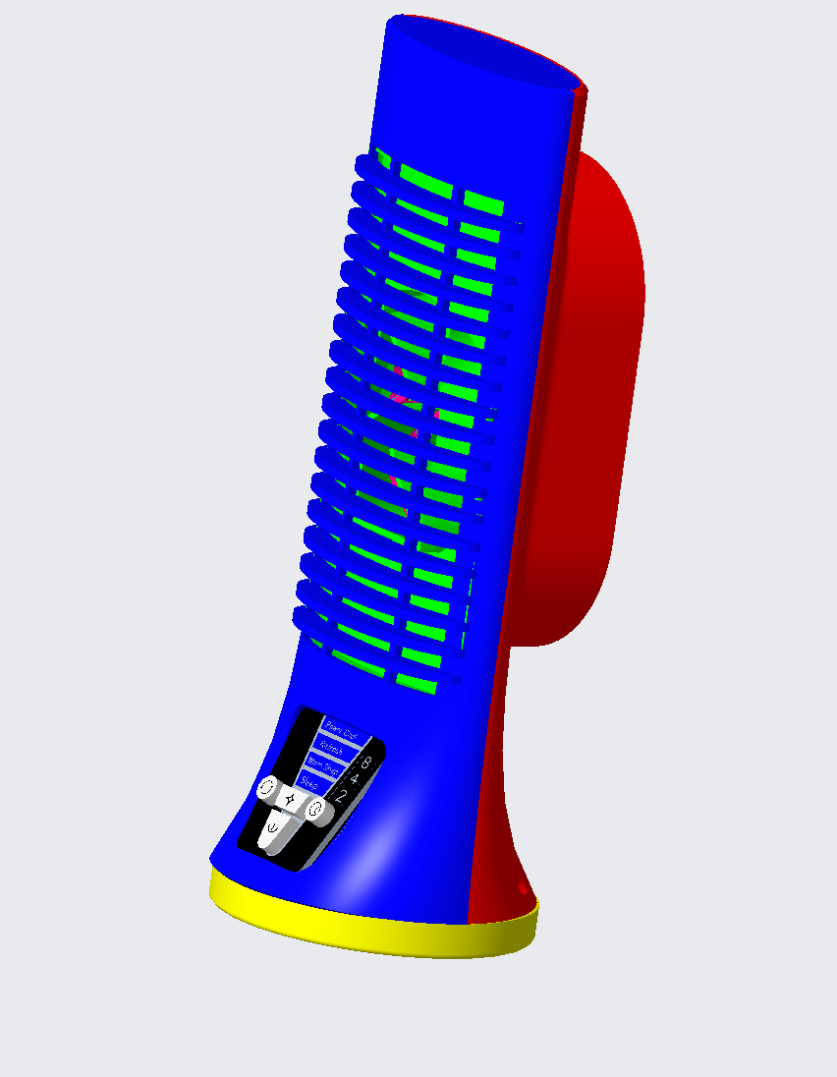
TOWER FAN
TEAM 24: ZAFIR ALI, KADE MCDANIEL, JUGO TAVARES

Slide 2
AGENDA
WHY
PRODUCT DESCRIPTION
MODEL ASSEMBLY
PART
PATENT

Slide 3
WHY TOWER FAN
OUR team has decided to do our project on the TOWER FAN. The reason is that it seemed like an interesting project that might test our modeling skills. It Is also interesting to learn how a tower fan that many people use works with its rotation function. Another functionality that it carries.

Slide 4
PRODUCT DESCRIPTION

Slide 5
PRODUCT DESCRIPTION
A Tower fan is a technological device to give a more powerful airflow. Tower fans work by having air being propelled forward with the blades causing it to spin and push out cool air. These are called impeller blades that move the air through the columns and out the vents. This tower fan has a small footprint, meaning it occupies less space. The advantages of having a tower fan are the design that lets it fit into small places, the weight that makes it affordable to carry around, and the gentle cooling provided to those using it. The only disadvantage of the tower fan might be the noise made while working, but this isn’t something intolerable that completely distracts the people around. Many people use this kind of fan daily to have a cool room with fresh air offering the best conditions to keep a chill environment where they can do all they need without the sensation of uncomfortably. Companies invest a lot of money in this product to give their employees the best atmosphere, which will motivate them to work harder, bringing benefits to the company.

Slide 6
ASSEMBLY

Slide 7
Assembly

Slide 8
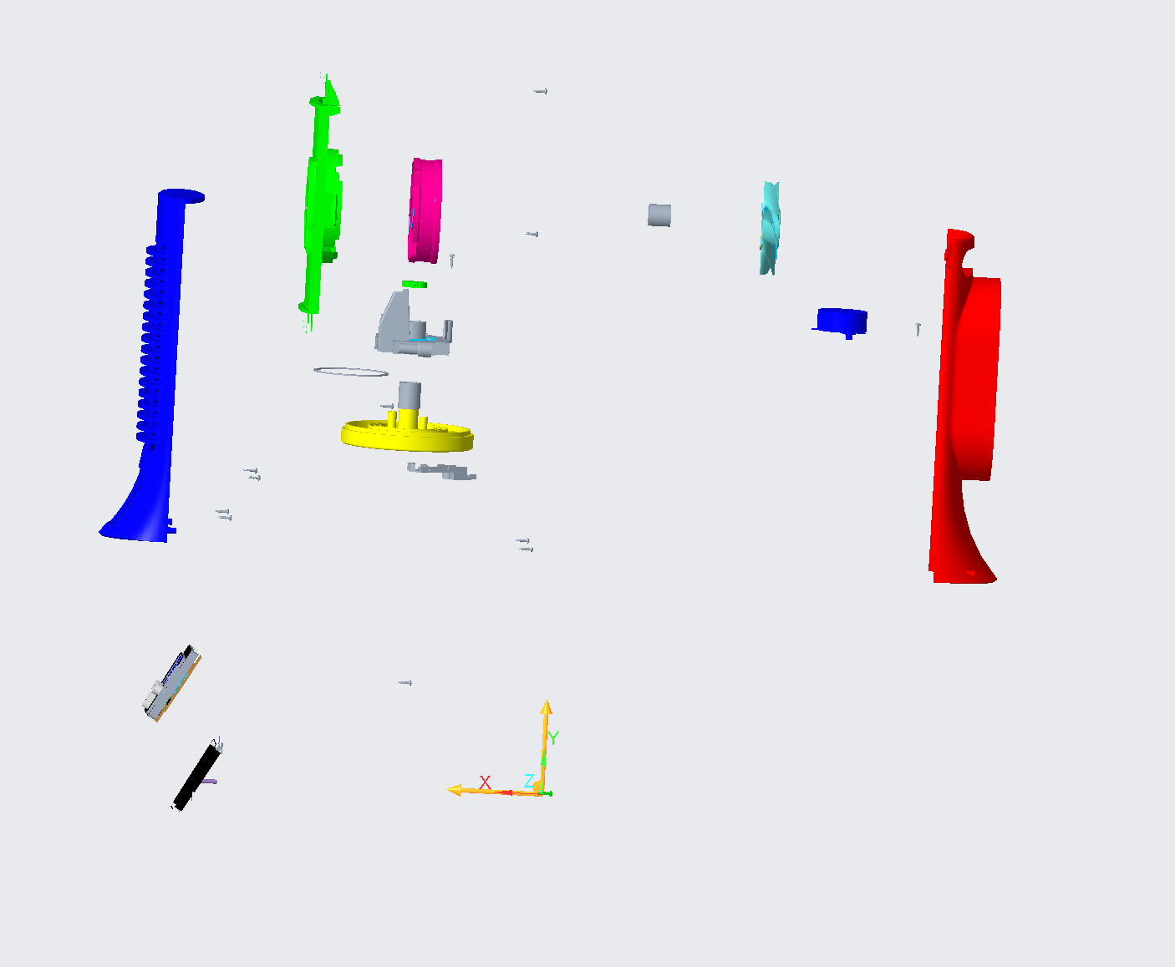
assembly (exploded view)

Slide 9
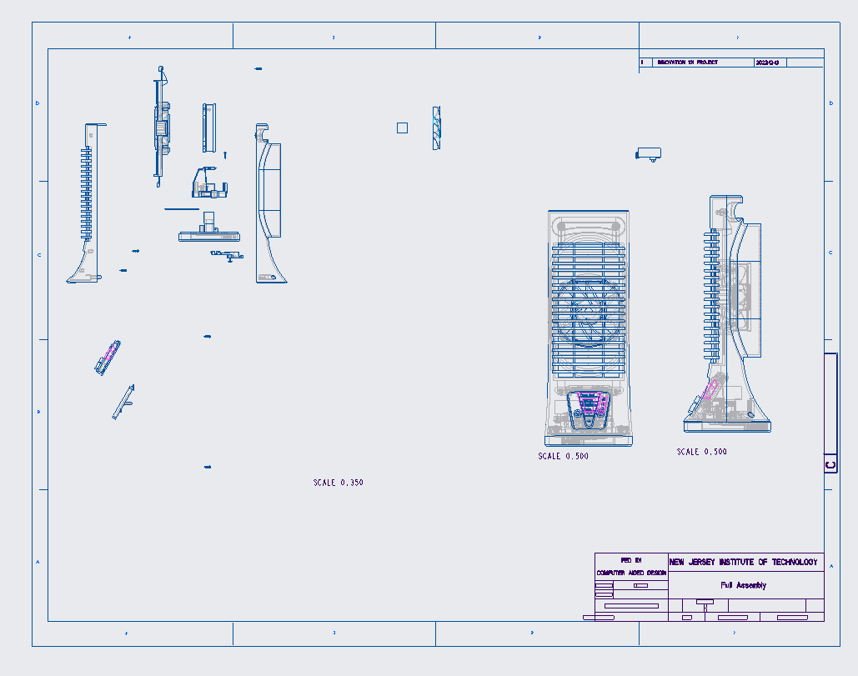
ASSEMBLY DRAWING

Slide 10
PARTS

Slide 11
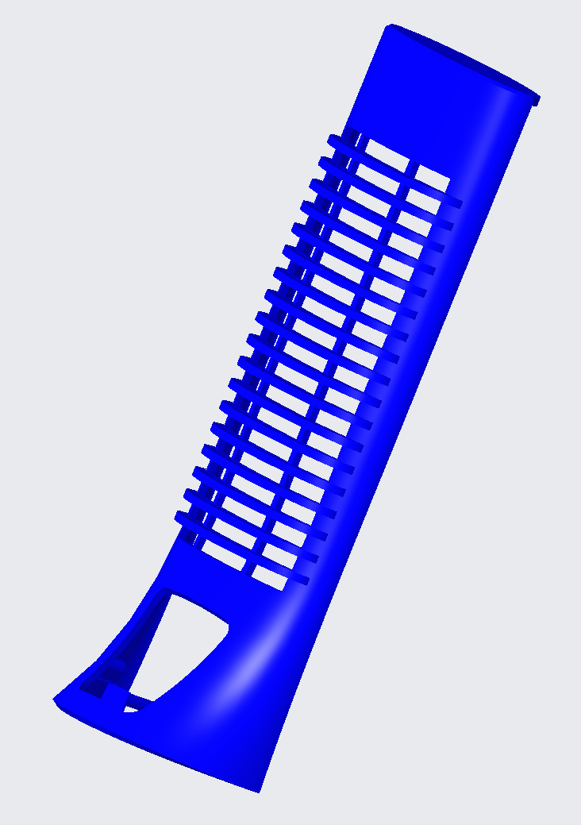
FRONT COVER

Slide 12
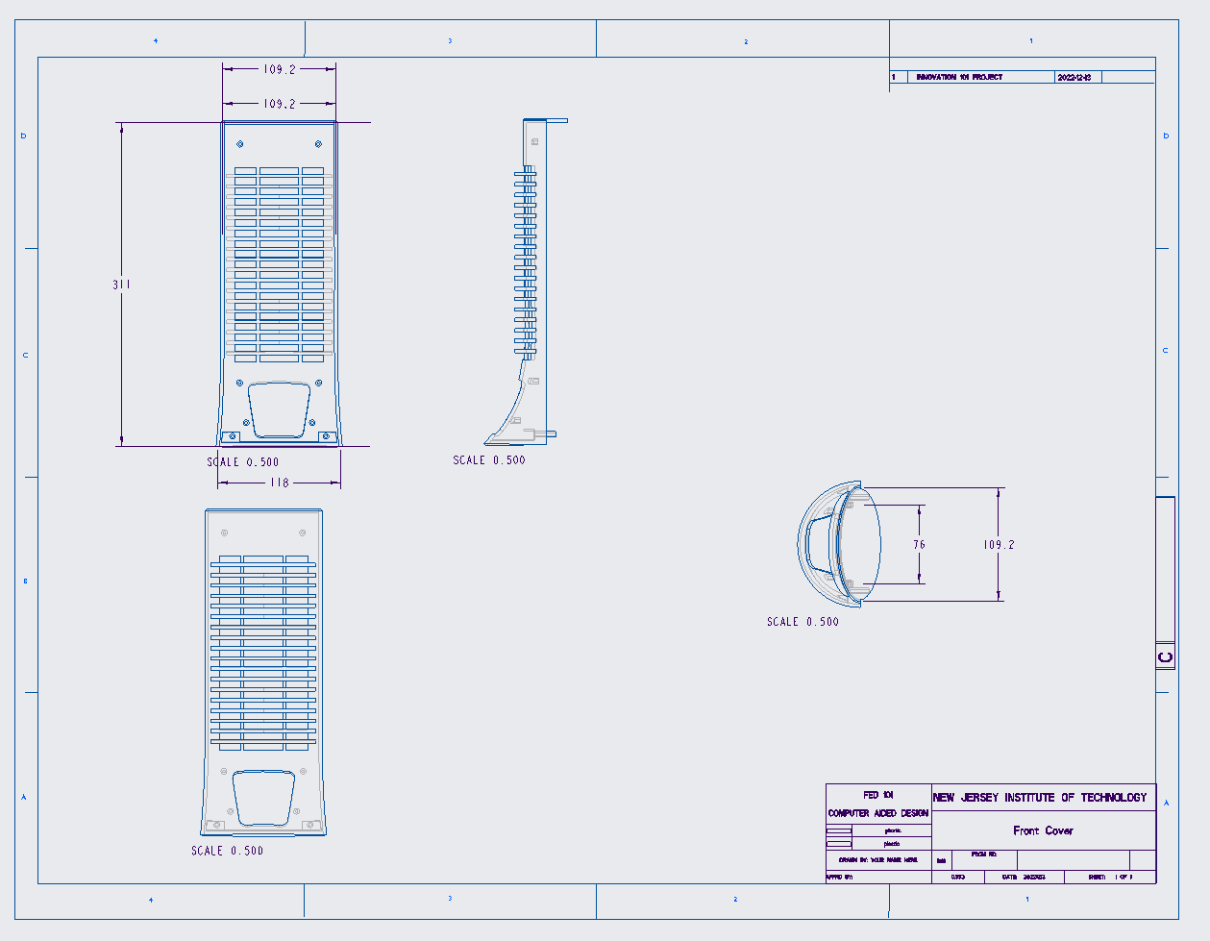
FRONT COVER DRAWING

Slide 13
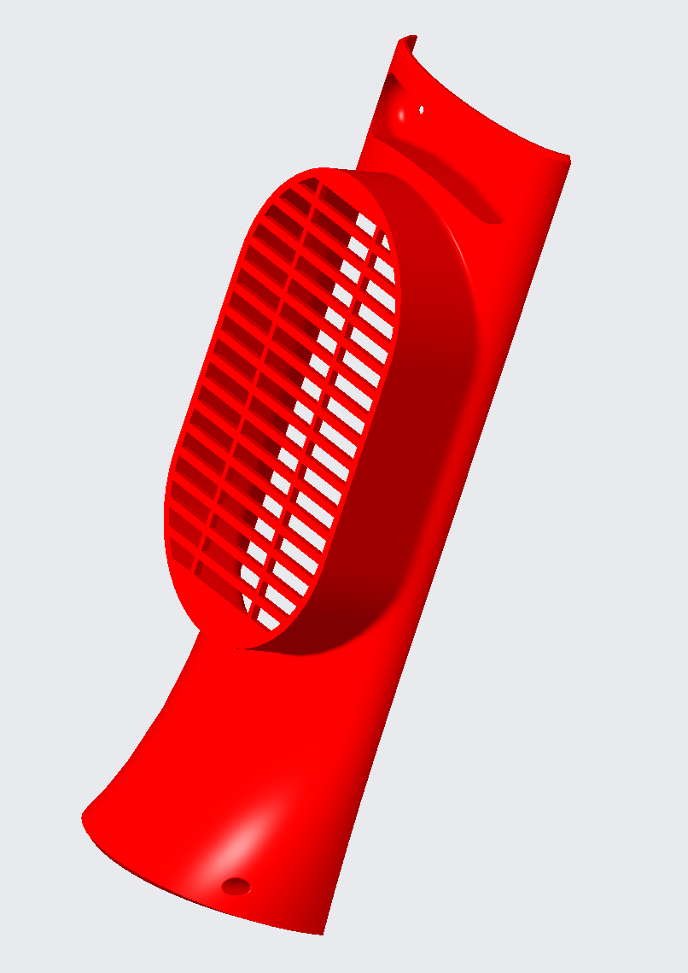
Rear COVER

Slide 14
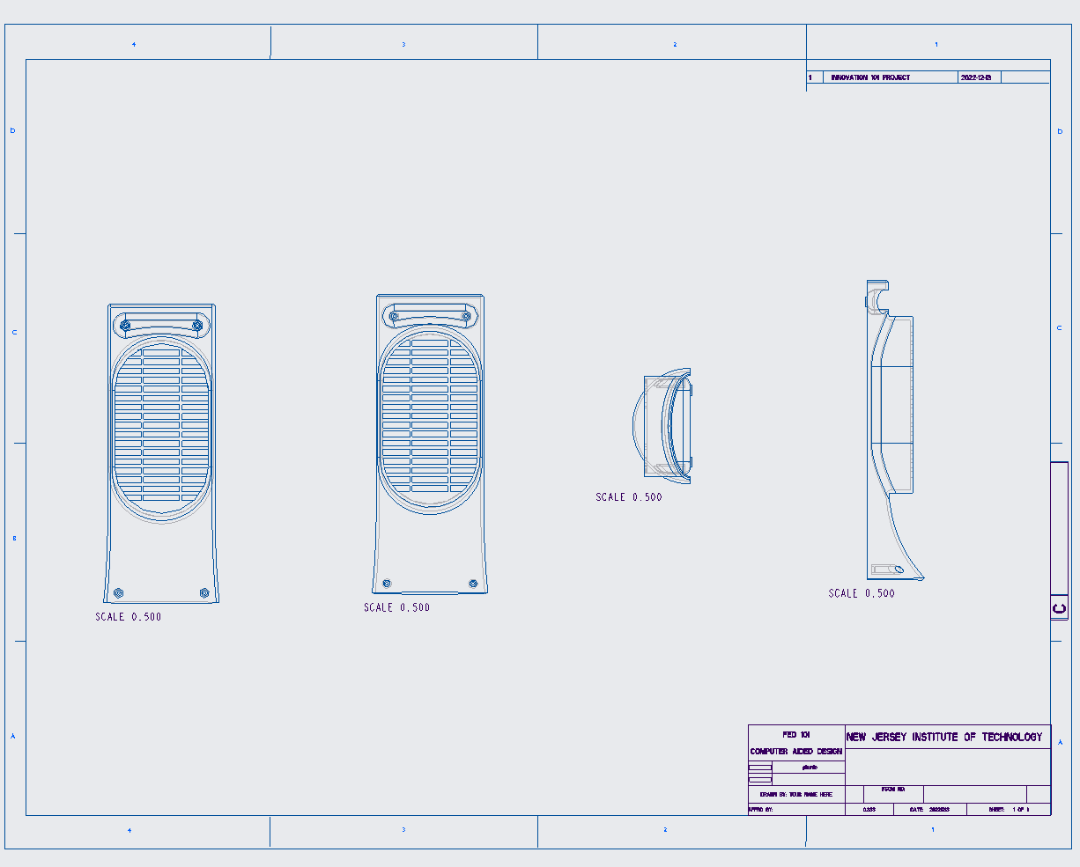
REAR COVER DRAWING

Slide 15
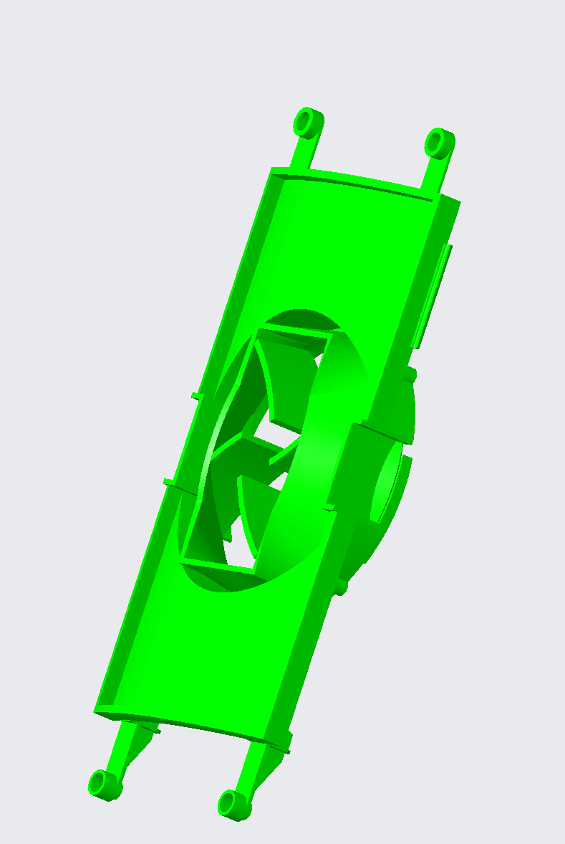
chassis

Slide 16
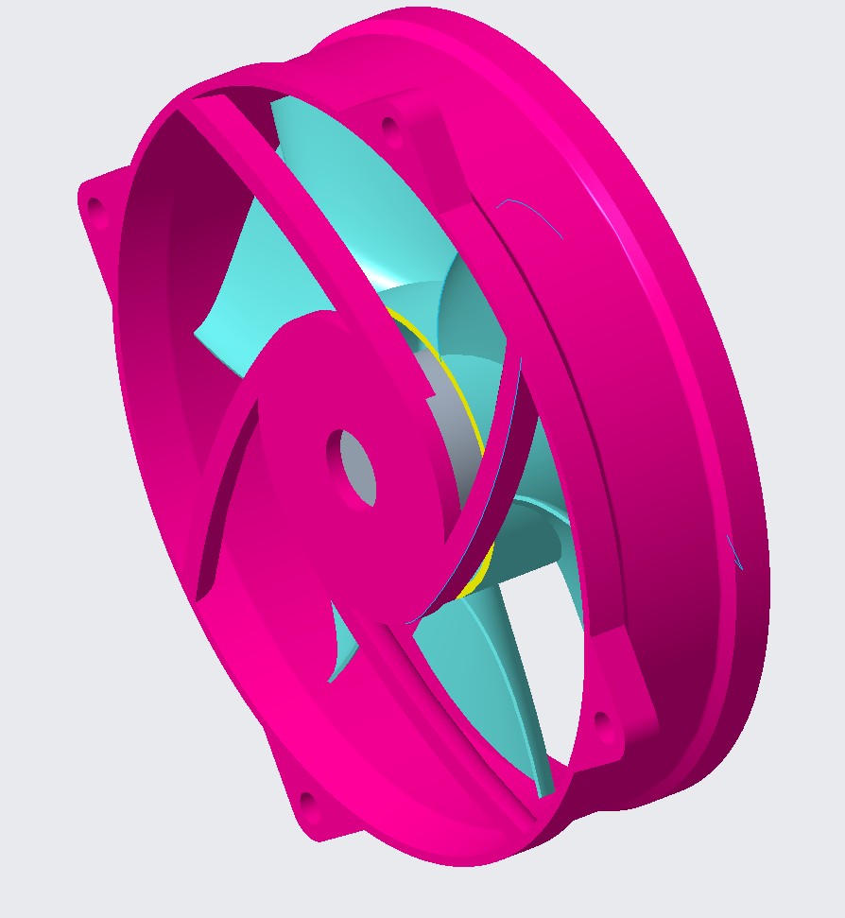
FAN

Slide 17
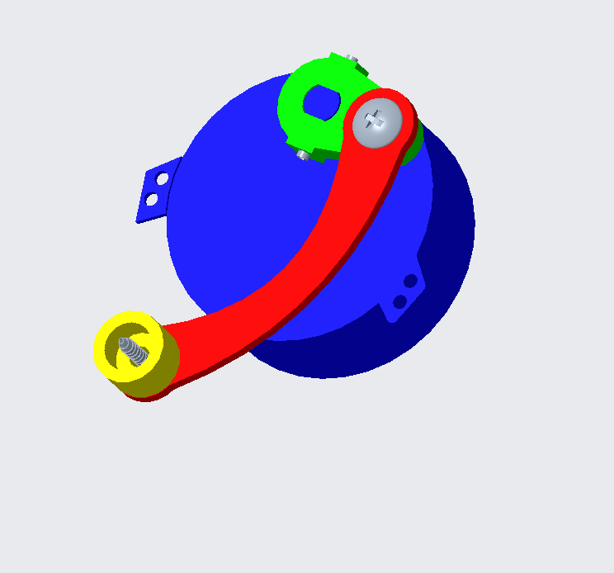
MOTOR

Slide 18
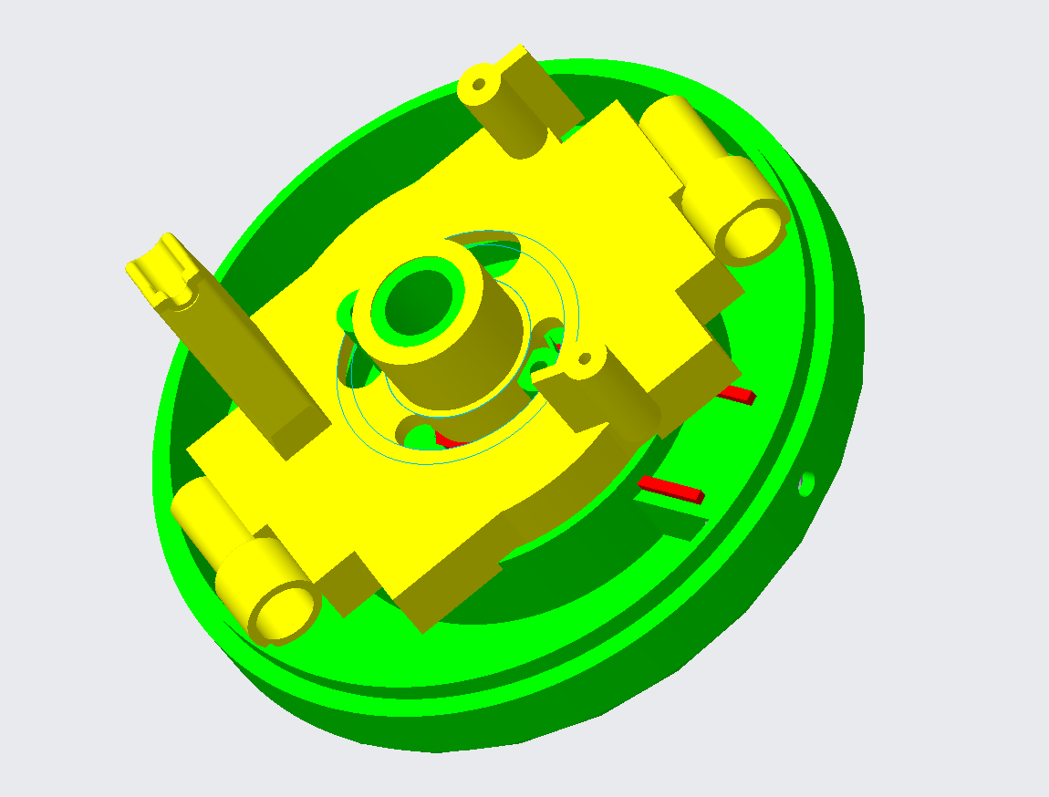
Pedestal

Slide 19
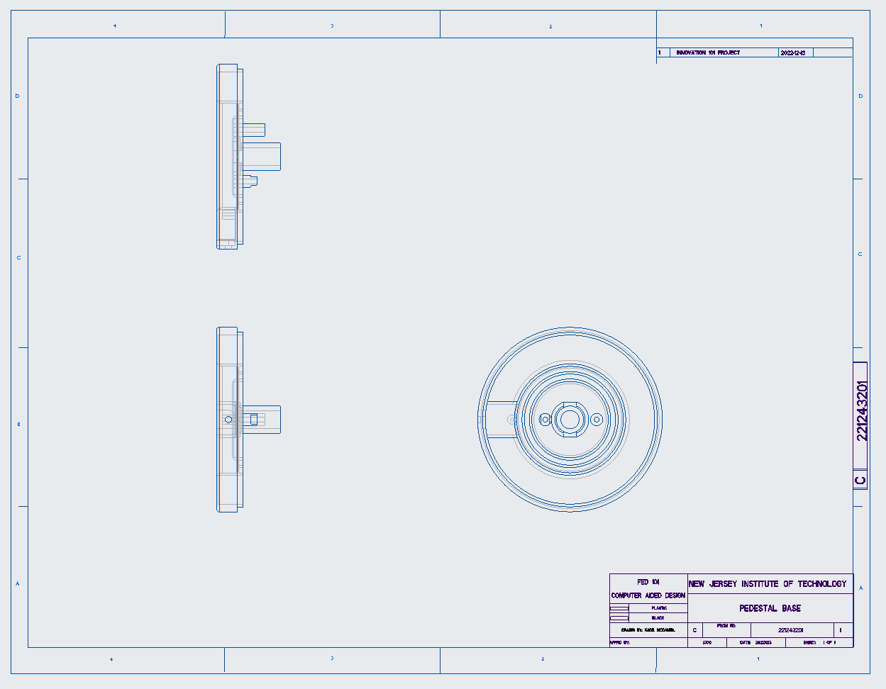
PEDESTAL DRAWING

Slide 20
patents

Slide 21
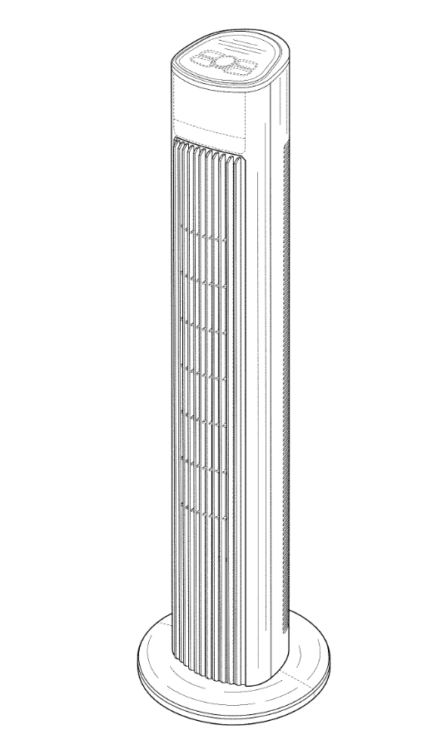
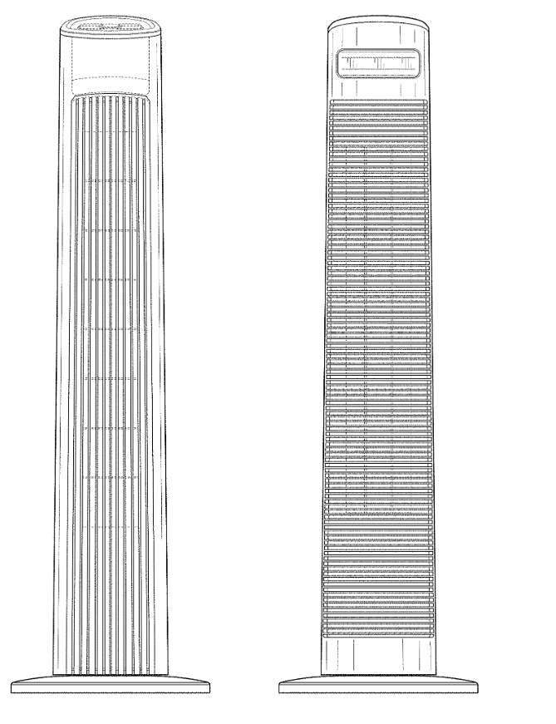
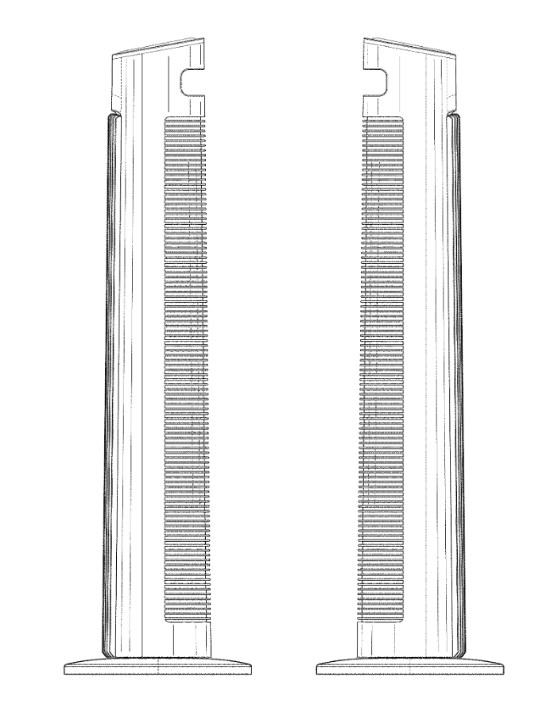
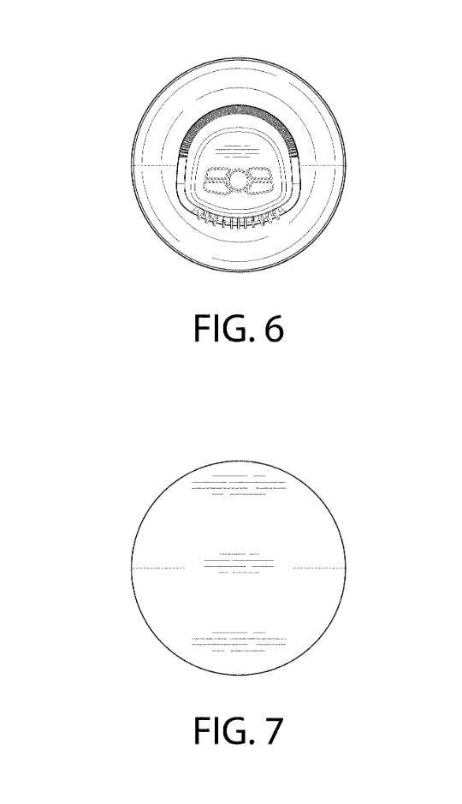
Patents: USD829319S1

Slide 22
What is it for?
This patent is for a generic design of a rotating tower fan. It is one of the first patents used and is used and cited by many companies that make tower fans such as Lasko and Samsung Electronics Co. In many cases it is using the patent for many different applications such as air conditioning, electric fans, and an electric fan.

Slide 23
THANK YOU
TEAM 24
ZAFIR ALI KADE MCDANIEL HUGO TAVARES

